Slide 1
BUS TICKET BOOKING SYSTEM- FastX
Trainer: JAVEED MOHAMMED HUSNUDDIN Presented By: Boreddy Sai Nishida

Slide 2
Technologies, Tools Used:
Backend Technologies:
Java with Spring Boot framework for building RESTful APIs.
Spring Data JPA with Hibernate for database interaction.
Spring Security with JWT for authentication and authorisation.
MySQL as the relational database for storing books, users, and Records.
Log4J for logging application events.
Frontend Technologies:
React with modern functional components and hooks.
Bootstrap for responsive UI design.
React Router DOM for client-side routing.
React Hook Form with validation.
Axios for HTTP API calls

Slide 3
Introduction
FastX Bus Booking System is a web-based application that automates bus ticketing operations by connecting travelers with available buses and routes. It allows administrators and operators to manage buses, schedules, and bookings, while users can search routes, select seats, book tickets, and track their travel history.
The system replaces manual ticketing processes with a scalable digital solution, improving efficiency, accuracy, and accessibility for both passengers and transport operators.

Slide 4
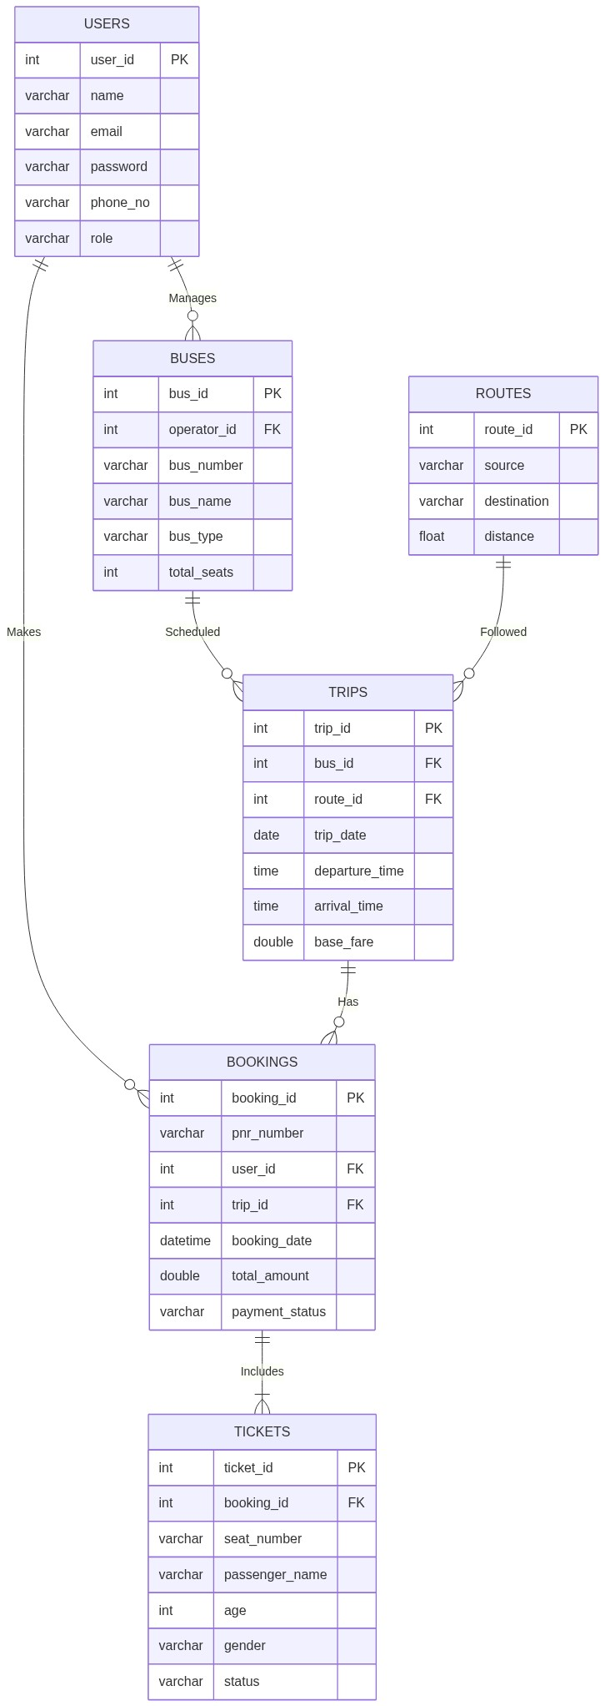
ER Diagram

Slide 5
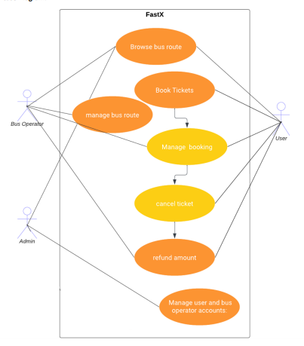
Use Case Diagram

Slide 6
Customer
The Customer is the end-user performing the actual ticket reservations.
Dynamic Bus Search: Search for available buses between two specific cities on a chosen travel date.
Interactive Seat Selection: View visual, real-time bus layouts, select specific seat numbers, and see live pricing based on seat type (e.g., Sleeper vs. Seater).
Multi-Passenger Booking: Book tickets for multiple passengers at once, entering specific details per seat (like name, age, and gender).
History: A personalized dashboard to view all upcoming and past trips securely.
Ticket Management: Check current Ticket Status via PNR, and securely cancel active tickets to receive automated refund updates.

Slide 7
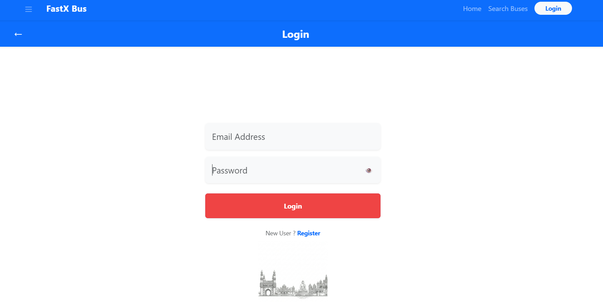
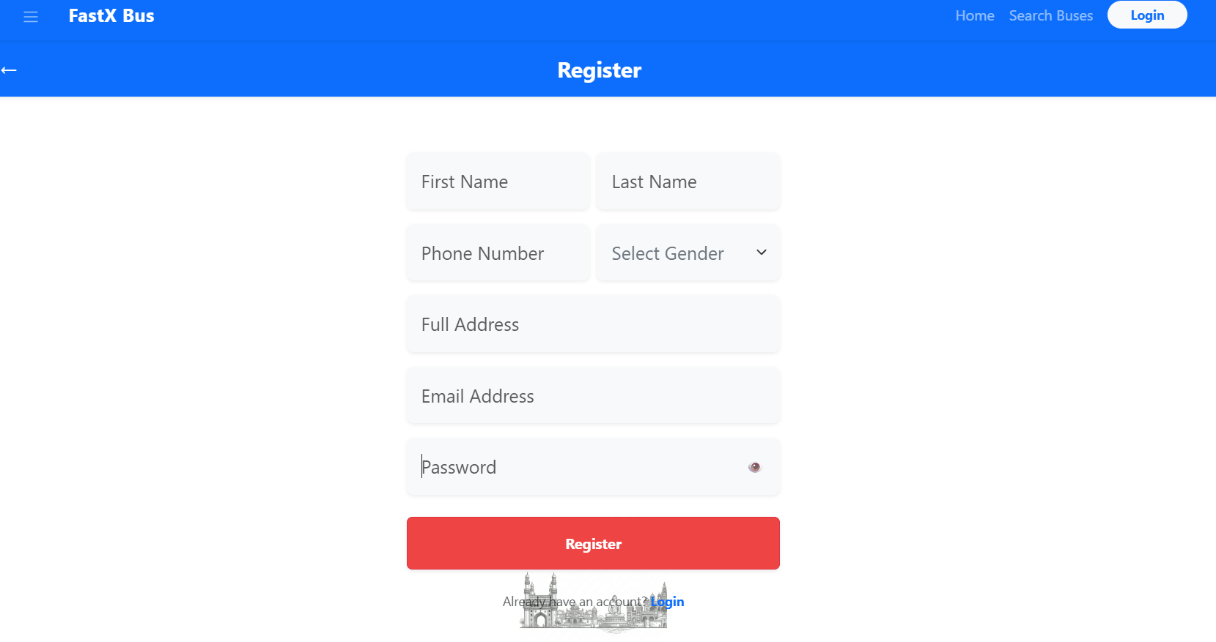
Login & Register Pages

Slide 8
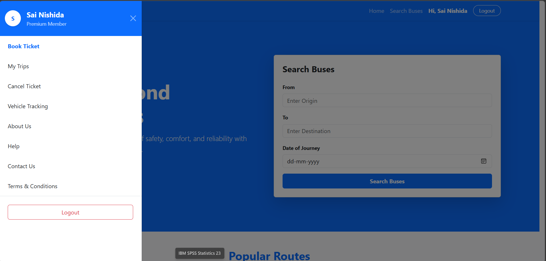
Customer Home Page

Slide 9
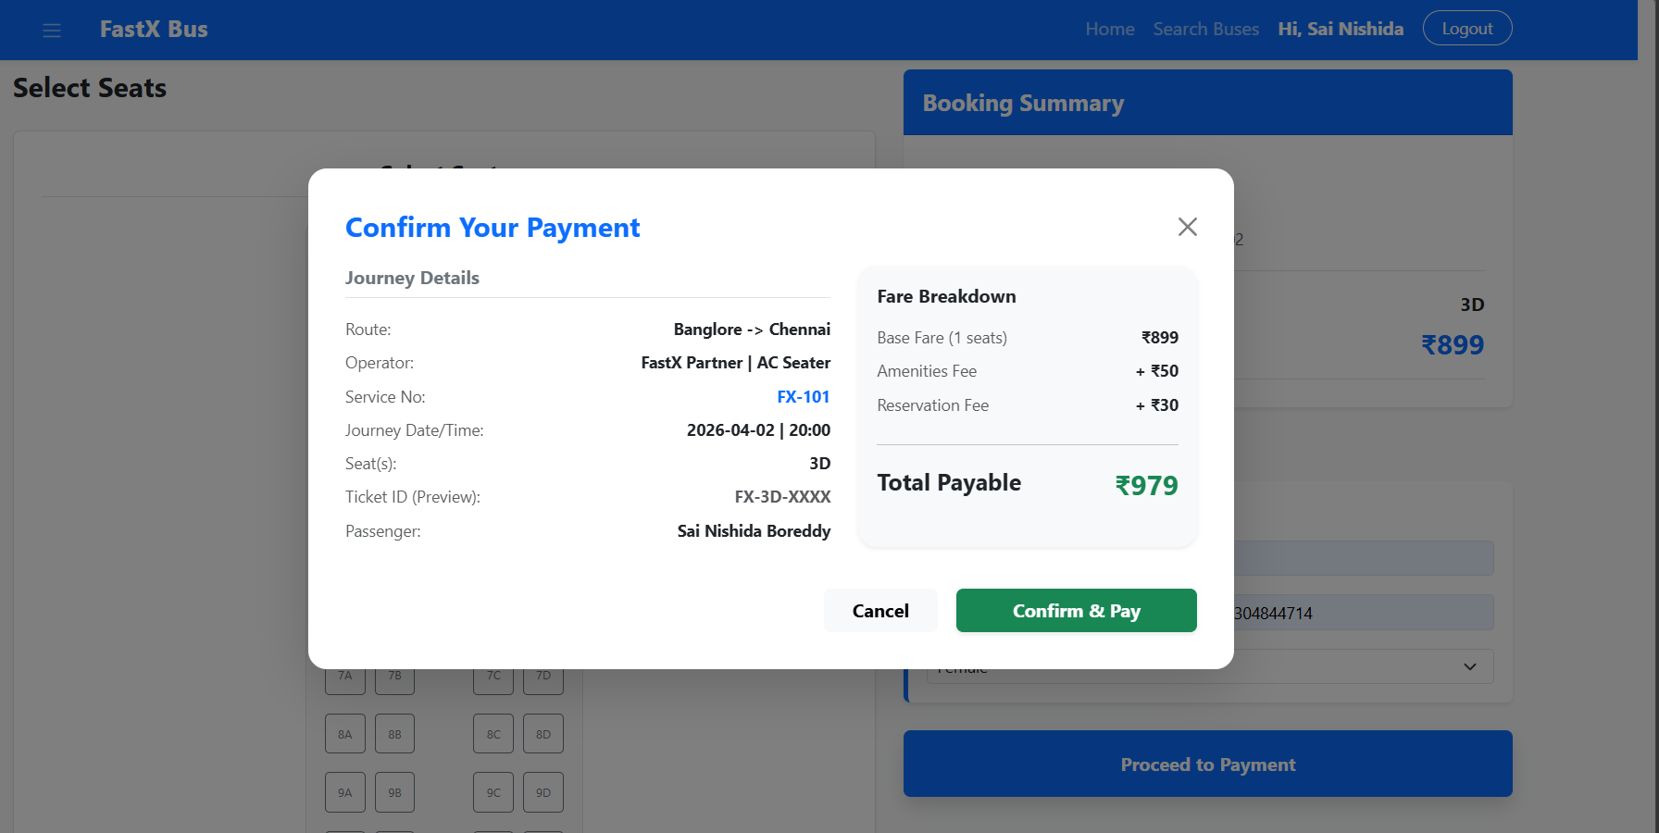
Seat Selection & Payment Pages

Slide 10
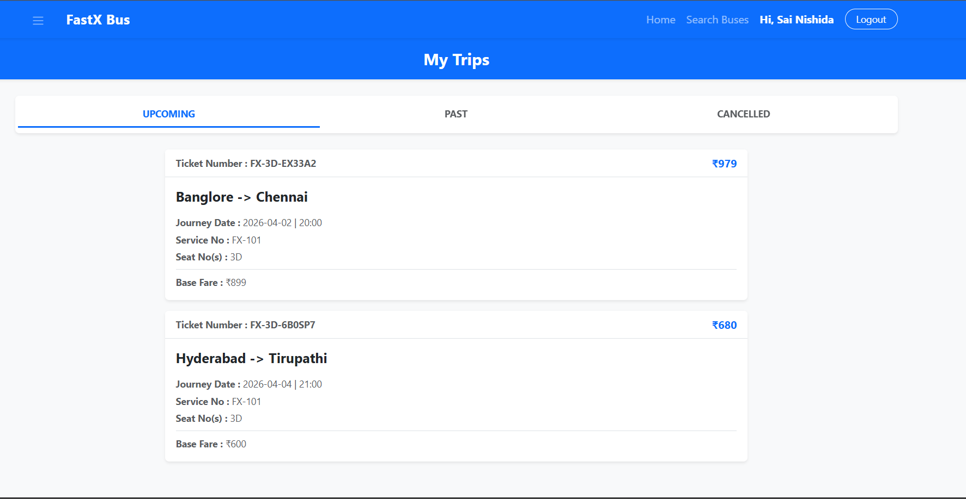
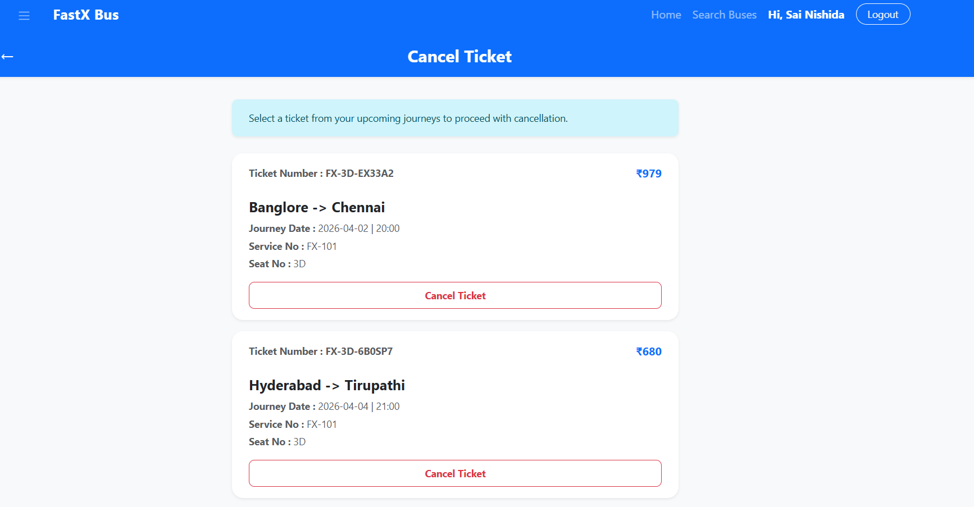
Customer My Trips &Cancel Ticket Pages

Slide 11
Admin Role
The Admin has global oversight over the entire business platform.
Dashboard & Analytics: View high-level metrics like total users, total system-wide bookings, total revenue, and total active buses.
Global Fleet Management: View every registered bus in the system, regardless of which operator owns it.
Route & Schedule Management: Create new service cities, define global routes (Source to Destination), and set up recurring route schedules (e.g., repeating trips every 3-5 days).
User Management: Manage all user and operator accounts to ensure security and valid access control.

Slide 12
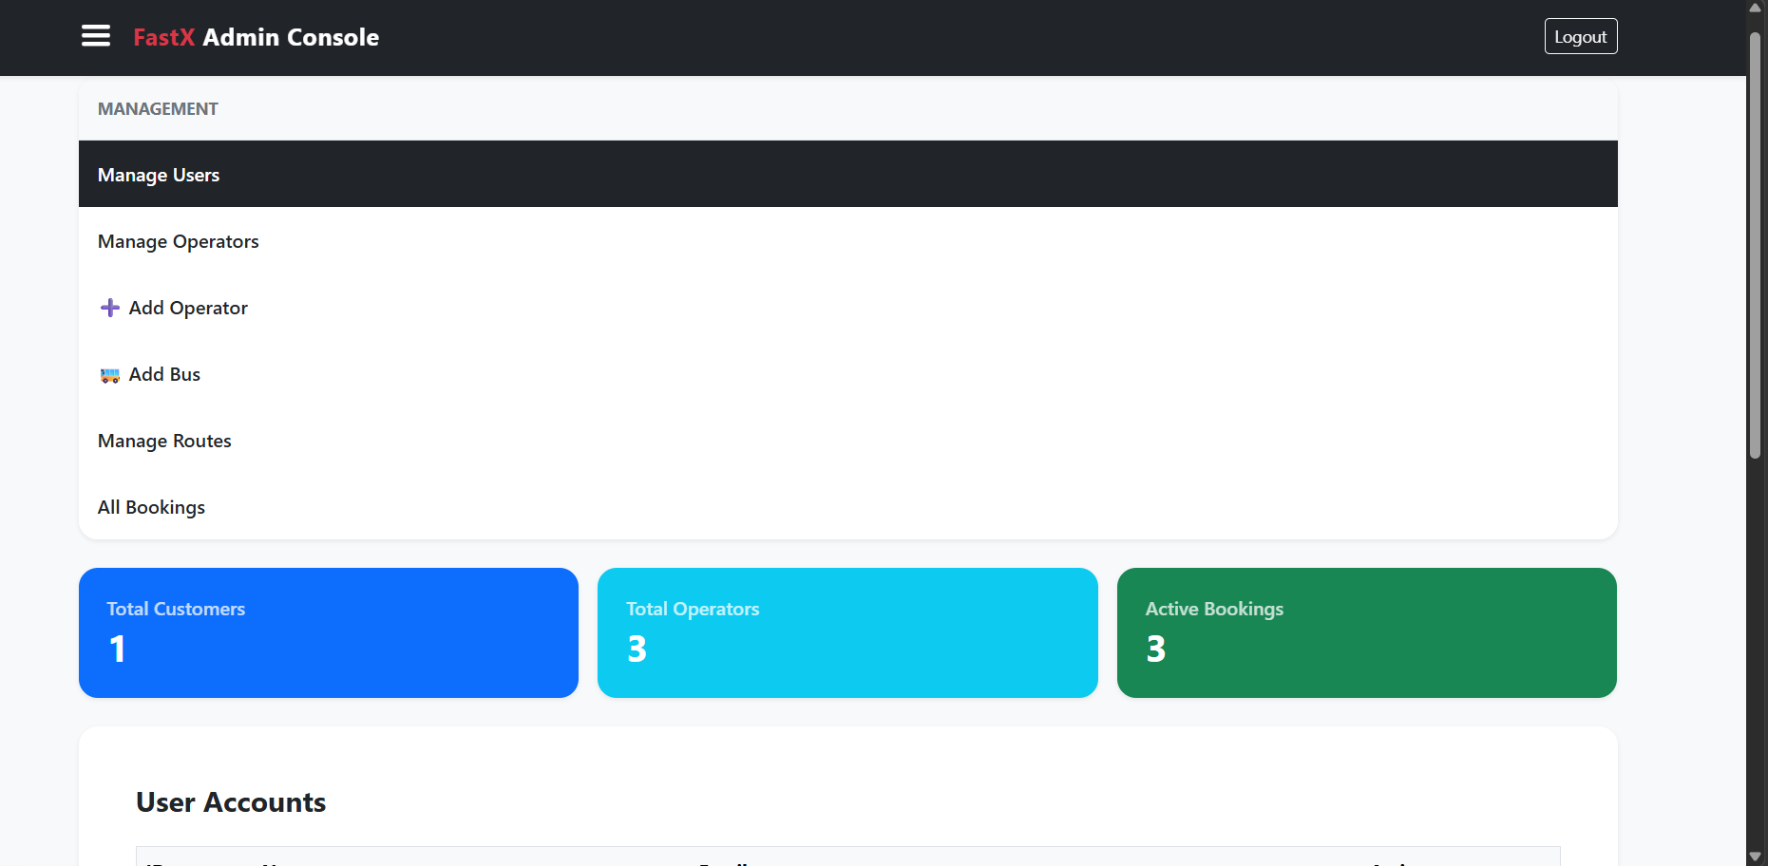
Admin Dashboard

Slide 13
Bus Operator Role
The Operator manages their own specific fleet of buses and is heavily restricted from seeing competitors' data.
Bus Registration: Add and manage their unique buses, specifying details like Bus Number, Layout Type (Sleeper vs. Seater), and capacities.
Trip Scheduling: Schedule trips on specific routes and dates specifically for the buses they own.
Booking Oversight: View a list of all passengers who have booked tickets exclusively for their buses.
Operational Dashboard: Track their own ticket sales, active scheduled trips, and revenue statistics without seeing the entire system's finances.

Slide 14
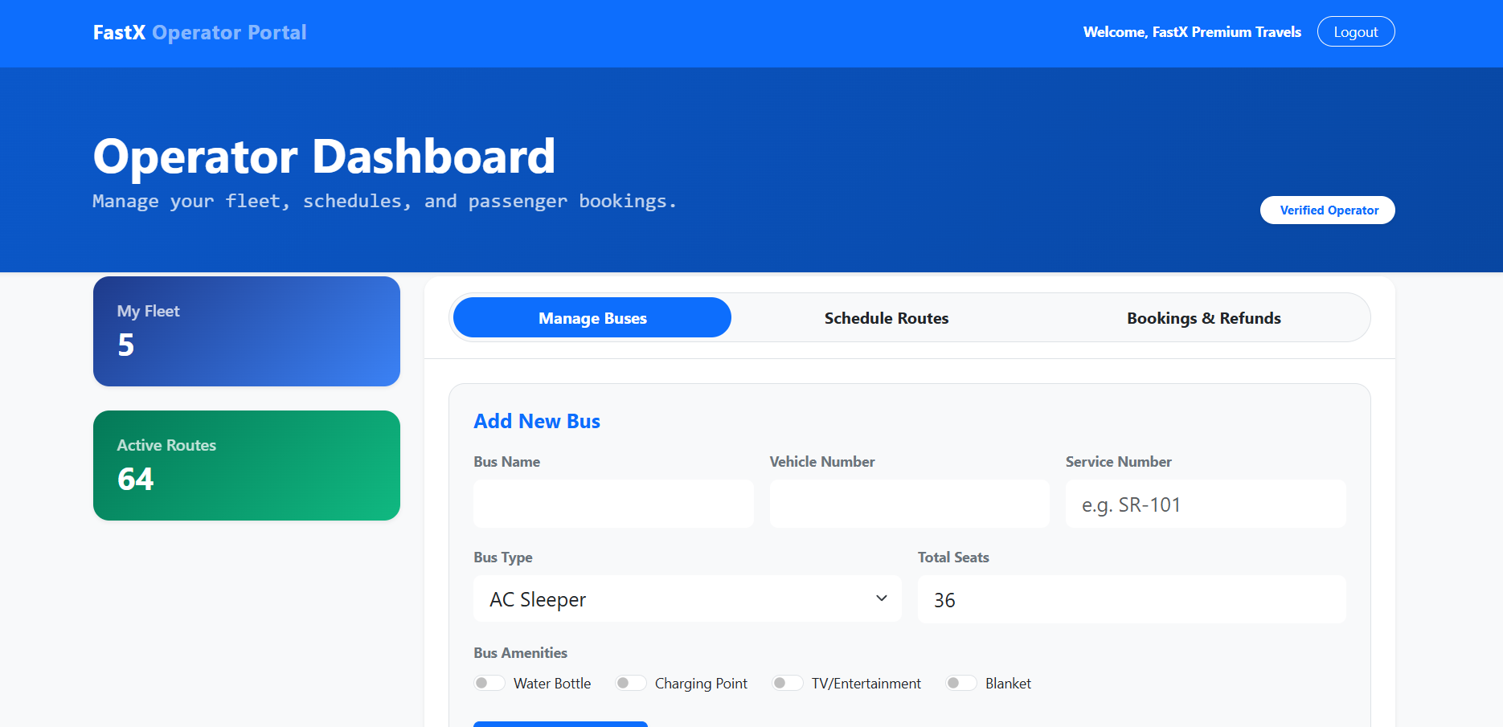
Bus Operator Dashboard

Slide 15
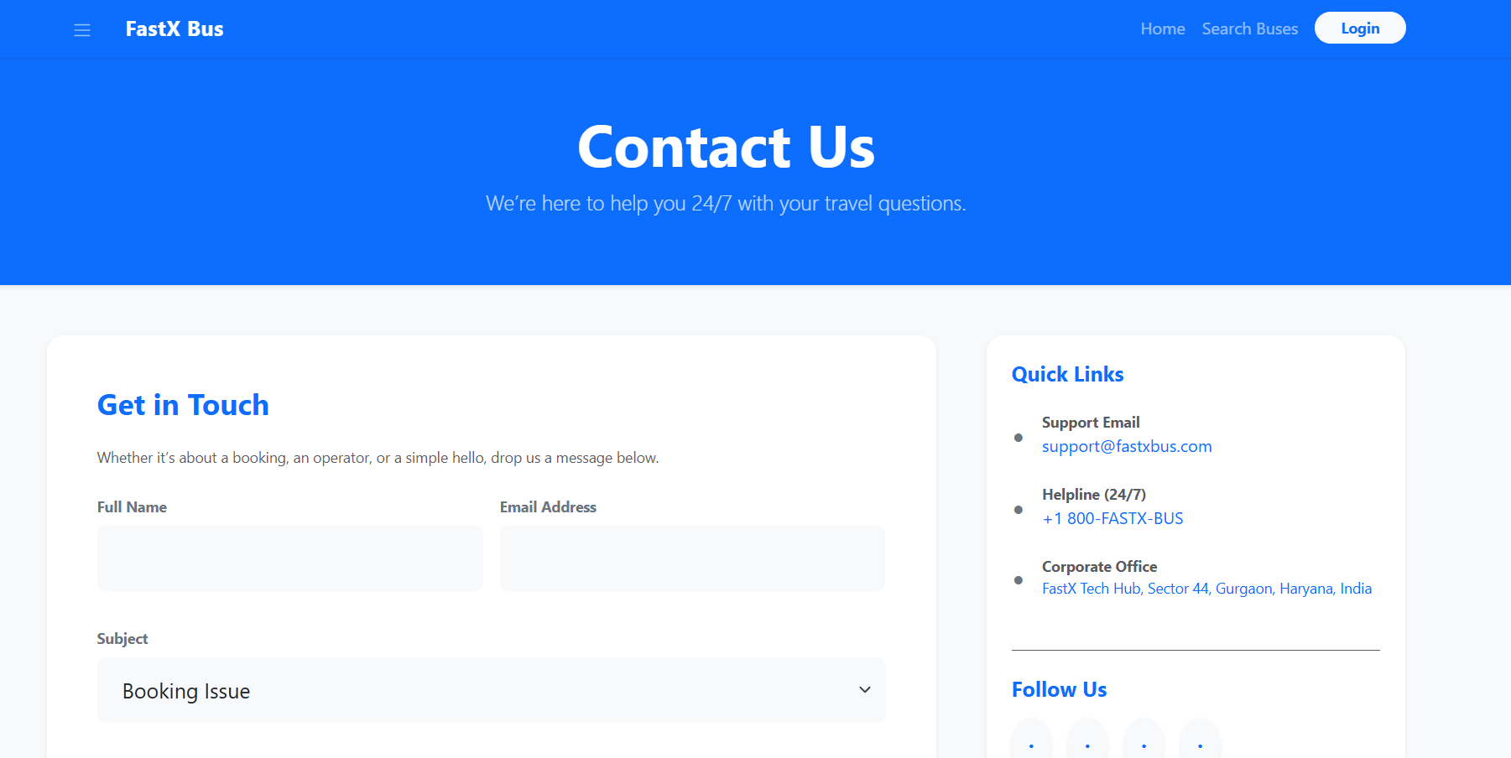
Thank You

